Slide 1
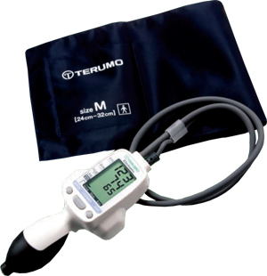

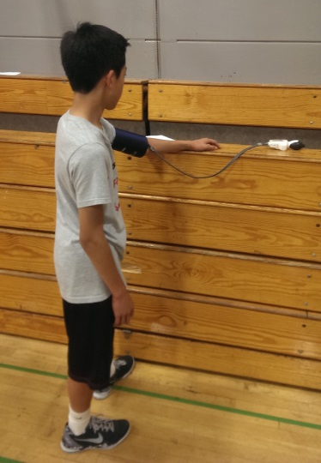
Abstract
Analysis
The purpose of this study is to determine if a relationship exists between physical exertion caused by a Physical Education (PE) class and scores on an academic test taken shortly after for eighth-grade students, and if so, what that relationship is. The hypothesis is that students taking a test shortly after PE would score lower than if they were not under the effects of PE. This study is important because it shows whether students are at a disadvantage if they undergo PE right before a test. Two experiments were conducted. The first experiment compared scores on tests taken by basketball players before and after practice. These subjects also had their blood pressure and pulse measured before each test to determine if any relationship exists between the changes in those biometric measures and test scores. The second experiment compared scores on a science test taken by students who just had PE to those who did not. Subjects of the first experiment scored, on average, 5.0% higher on the test after PE. There was no significant relationship between changes in blood pressure and pulse and changes in scores. Subjects with PE of the second experiment outscored the non-PE students by an average of 5.5%. These results contradict the main hypothesis, and instead show that physical exertion caused by PE actually improves test scores.
Results of the first experiment are shown in Tables 1 and 2 and Graphs 1, 2A, and 2B. Table 1 shows test scores before and after basketball practice, as well as the mean change of these values. Table 2 shows changes in heart rate, systolic blood pressure, and test score for each subject. Graph 1 shows the relationship between test scores before and after basketball practice. The average test score after basketball practice was 80.0%, while the average test score before practice was 75.0%. On average, the subjects scored 5.0% higher after basketball practice. Graph 2A shows the relationship between the change in heart rate and the change in heart scores. No significant relationship was found between these two values (r ≈ -0.07). Similarly, Graph 2B shows the relationship between the change systolic blood pressure and the change in test scores. Again, no significant relationship was found (r ≈ -0.12).
Results of the second experiment are shown in Table 3 and Graph 3. Table 3 shows the average test score of students who had just taken a PE class, the average test score of students who had not just taken a PE class and the difference of the two scores. Graph 3 organizes the information of Table 4 into a graph. When looking at the combined scores for both tests, the PE group scored an average of 91.9%, while the non-PE group scored an average of 86.4%. The PE group outscored the non-PE group by an average of 5.5%.
Results
Date | Mean Average Test Score (%) Before Practice | Mean Average Test Score (%) After Practice | Mean Change of Test Scores (%)
1/10/14 | 64.0% | 76.0% | 12.0%
1/17/14 | 82.9% | 82.9% | 0.0%
Average | 75.0% | 80.0% | 5.0%
Introduction
Table 1: Mean Average and Change of Test Scores Before and After Practice
Text Here
Date | Subject | Change in Heart Rate (bpm) | Change in Systolic Blood Pressure (mmHg) | Change in Test Score (%)
1/10/14 | A | 37 | -11 | 10
 | B | 47 | -12 | 30
 | C | 20 | -19 | 30
 | D | 52 | -18 | -20
 | E | 28 | -15 | 10
1/17/14 | A | 22 | -6 | -20
 | B | 26 | -27 | 0
 | C | 12 | -13 | -10
 | D | 7 | -18 | 10
 | E | 38 | -3 | 0
 | F | 23 | -13 | 0
 | G | 16 | -10 | 20
Discussion
The first experiment showed that the average score on an academic test taken after basketball practice was 5.0% higher than the average score on a similar test taken before basketball practice. The second experiment showed that students who had just taken a PE class prior to a science test scored 5.5% higher than students who had not just taken a PE class. These results are similar to the results found in a study which said that exertion caused by stationary bike riding improved mental performance on a cognitive task (Jickling, 1972).
A possible explanation for these results is that physical exertion caused the heart to pump more blood and at a faster pace in order for muscles to perform at a higher level. As a result, blood flow to the brain also increased. This extra blood flow helped the brain to perform more efficiently. Also, exercise might help the student to think less about the upcoming test. This would lead to less stress and anxiety, which are known to increase test scores (Rose, 2010).
Reasonable errors for the first experiment include limited subject material on the tests, a disparity between the difficulties of the tests, and distractions such as noise while taking the tests. To correct this in the future, tests that are more diverse in subject material and equal in difficulty level could be written, and the test could be taken in a quieter environment.
Reasonable errors for the second experiment include the use of only science tests, not enough people in the experimental group, and a difference in intelligence between the experimental and control groups. In order to correct these errors in a future experiment, tests for other school subjects and a larger experimental group could be used.
Materials and Methods
Text here
Table 2: Changes in Heart Rate, Systolic Blood Pressure, and Test Score for Each Subject
Date | Class | Mean Average Test Score for Subjects with Previous PE/Dance Class (percent) | Mean Average Test Score for Subjects Without Previous PE/Dance Class (percent) | Group with Higher Test Score | Difference of Test Scores (percent)
12/13/13 | Regular | 81.0% | 69.0% | PE/Dance | 12.0%
 | Accelerated | 95.0% | 93.6% | PE/Dance | 1.4%
 | Total | 92.5% | 84.8% | PE/Dance | 7.7%
1/10/14 | Regular | 83.3% | 75.7% | PE/Dance | 7.6%
 | Accelerated | 93.2% | 94.4% | No PE/Dance | 1.2%
 | Total | 90.9% | 87.9% | PE/Dance | 3.0%
Total | Regular | 82.2% | 72.2% | PE/Dance | 10.0%
 | Accelerated | 94.3% | 94.0% | PE/Dance | 0.3%
 | Total | 91.9% | 86.4% | PE/Dance | 5.5%
Conclusions
The hypothesis stated that if a student takes a test shortly after physical exertion cause by PE class, then his or her test scores will be lower than if he or she was not under the effects of physical exertion. However, based on the results, the hypothesis has been rejected, and the conclusion is that physical exertion actually improves scores on a test.
This experiment shows that physical exertion due to PE may improve test scores. Because of this effect, students without a PE class right before the test should try to find a way to simulate exercise just before any tests throughout the day. This physical exertion may lead to a higher test score.
Further Research
Picture 1: A Terumo Medical Elemano Hybrid Blood Pressure Monitor
Picture 2: A subject taking a test
Picture 3: A subject using a Terumo Unit
Table 3: Mean Averages and Differences of Test Scores for Subjects with and Without Previous PE/Dance Class
A future question to ask would be “How do different levels of physical exertion caused by PE affect scores on an academic school test taken shortly after by eighth-grade students?”

